Slide 1
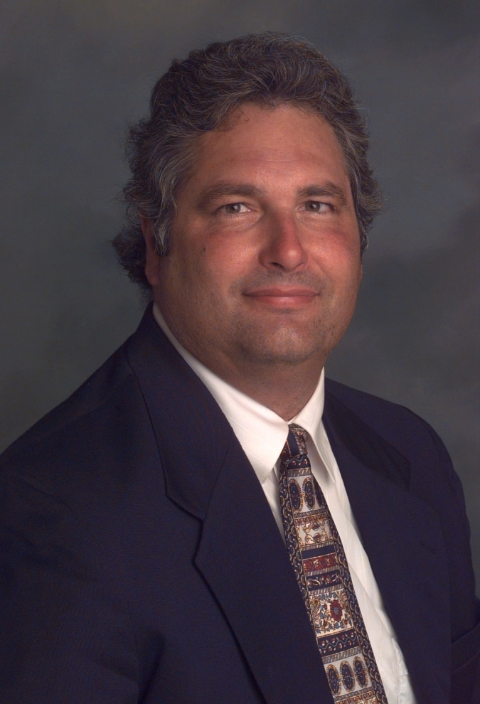
Data Science in L.A.'s “Silicon Beach”: Shadow Vocation or Emergent Profession?
2015 CSU-POM Conference
CSU Northridge
Saturday, February 28, 2015
Wayne Smith, Ph.D.
Department of Management
CSU Northridge
ws@csun.edu
This presentation is available at:
smithw.org/csupom.pdf or github.com/wsphd/csupom/

Slide 2
Motivation
Background/Preliminaries
I apologize…
“cloud computing”, “big data”, “[xyz] analytics”, and perhaps most confusing of all, “data science”
These are generally industry buzz “terms”, not necessarily our terms.
I prefer decision-support systems, predictive modeling, statistical computing, and mathematical optimization, but most of the folks I routinely work with prefer the term “data science”. We might, however, agree on the terms reproducible research, data analytics and information visualization.
I am on the steering committee for the LA R/Data science Meetup group
There are a few other Ph.D.s heavily involved too—Szilard Pafka (primary lead), David McArthur, Rob Gould, Jeremy Miles, Tim Triche, Eduardo Arino de la Rubia, and others
“Data as the new Oil” Challenges and Opportunities
Is there a perturbation (disequilibrium) in this labor market?
Exactly what is the production, operations, transportation, logistics of bits viz. atoms?
What is our institutional role (if any) in this (increasingly, non-college) community?
Are we witnessing the emergence of a new data guild in the modern service economy?

Slide 3
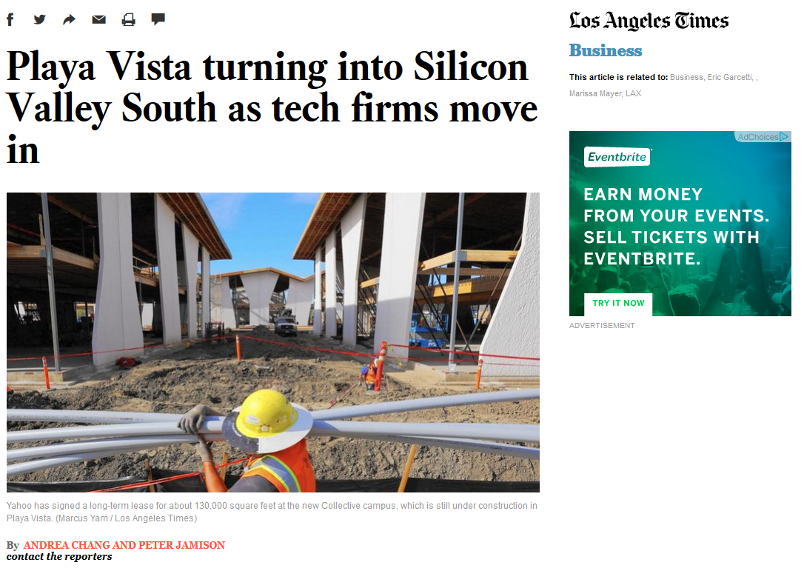
http://www.latimes.com/business/la-fi-silicon-valley-south-20150118-story.html#page=1

Slide 4
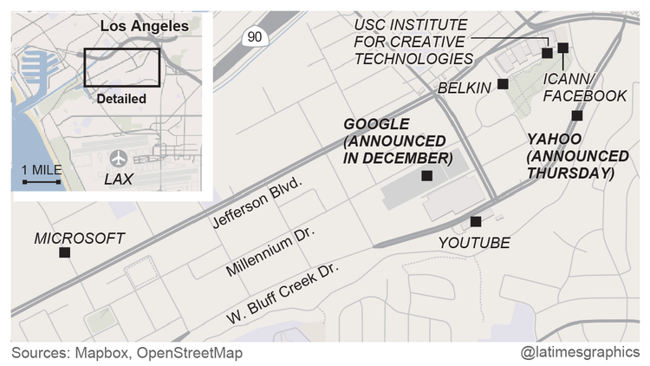

Slide 5
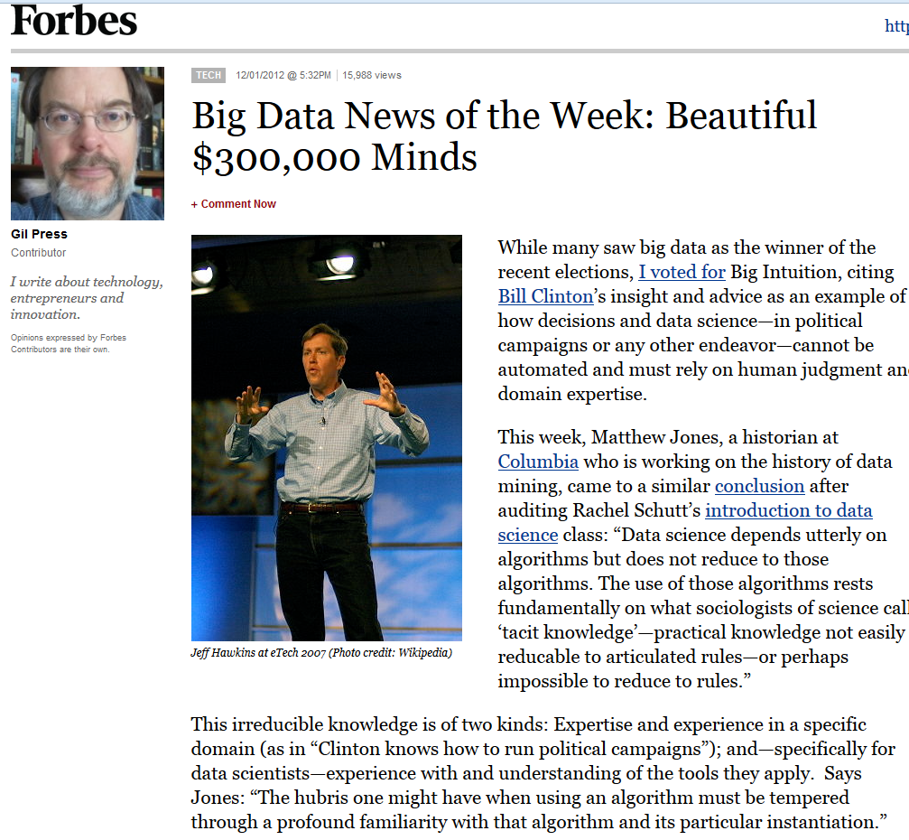

Slide 6
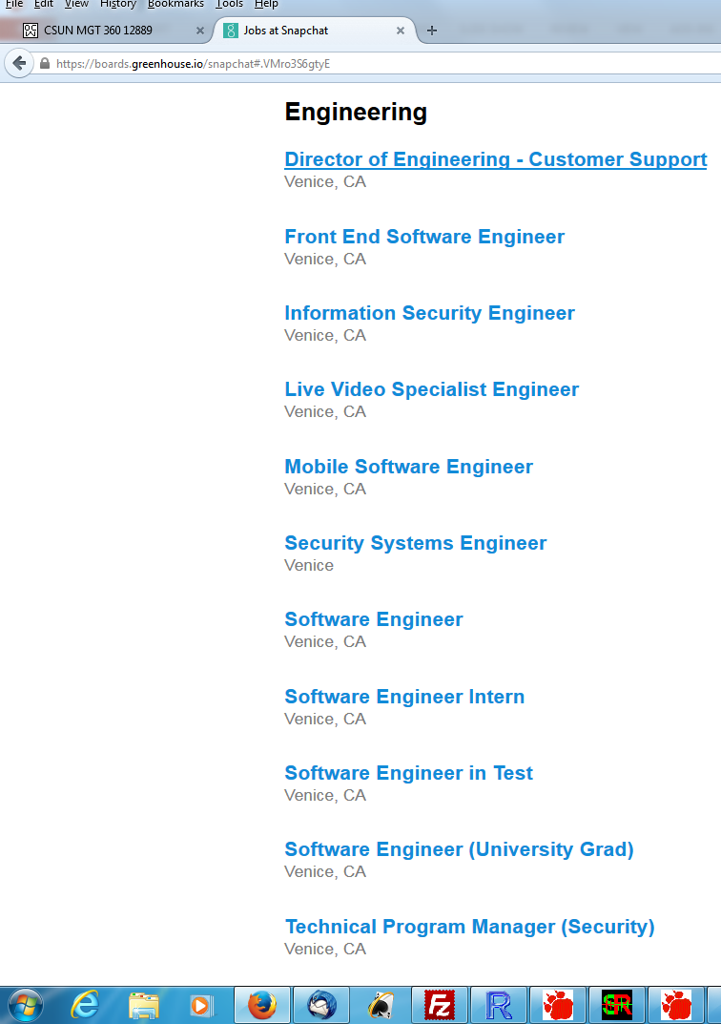
Difference at B.A./B.S. level ― recommended or required (Snapchat)

Slide 7
Some tools (other than R)
COTS (Non-FOSS)
SAS, IBM SPSS, Stata, S-PLUS, BMDP, Lisrel, EQS, HLM, MPLUS, SmartPLS, …
Mathematica, @Risk/Excel add-ins, RATS, Matlab, Simscript, Arena, etc.
IBM Netezza, MS Anal. Serv., Oracle Adv. Anal., SAP HANA, Teradata Miner, etc.
UCINET/NVivo/Tropes, ConQuest, ArcGIS, AutoDesk, etc.
IBM CPLEX, MOSEK, GUROBI, Frontline, etc.
FOSS/GNU
Domain-specific?
GRETL/xBUGS, Ggobi, Pajek, lisp-stat, Netlib/BLAS/LAPACK/FFTPACK, etc.
Sage, Octave, Scilab, Java/Colt/JFreeCharts, Gephi, incanter, Protovis, D3, etc.
G(NU)LPK, COIN-OR, NLOpt, CSDP, BLAS, NASTRAN, WordNet, statconn, etc.
General-purpose?
jQuery/jqueryUI/flot/jstat, BIRT, RapidMiner, Pentaho, MongoDB, etc.
Apache Hadoop/Spark/Flink/Solr/CouchDB/Lucene/OpenNLP/Mahout, etc.
Python ― iPython/NumPy/matplotlib/statmodels/Blaze/Bokeh/scikit-learn, etc.
Julia ― iJulia/Juno/MultivariateStats/MLBase/TimeSeries/Gadfly/JuMP, etc.

Slide 8
General Coordination
Monthly Meetups (physical, not virtual)
E.g., www.datascience.la
Monthly meetings (50-200 people)
By language/platform/environment: R, Python
By technology/workflow: Visualization, DW/BI, Machine Learning
By sector/domain: AdTech, FinTech
By management “level”: a few directors- and mangers-only events (by invitation only)
Annual Conferences (physical, not virtual)
E.g., “Big Data camp” at Direct TV (El Segundo)
http://insidebigdata.com/2014/06/03/free-conference-big-data-camp-2014/
Multiple, parallel tracks
Vendor support (all expenses covered fully)
Last three years’ attendance—200 (2013), 500 (2014), 800 expected (2015)

Slide 9
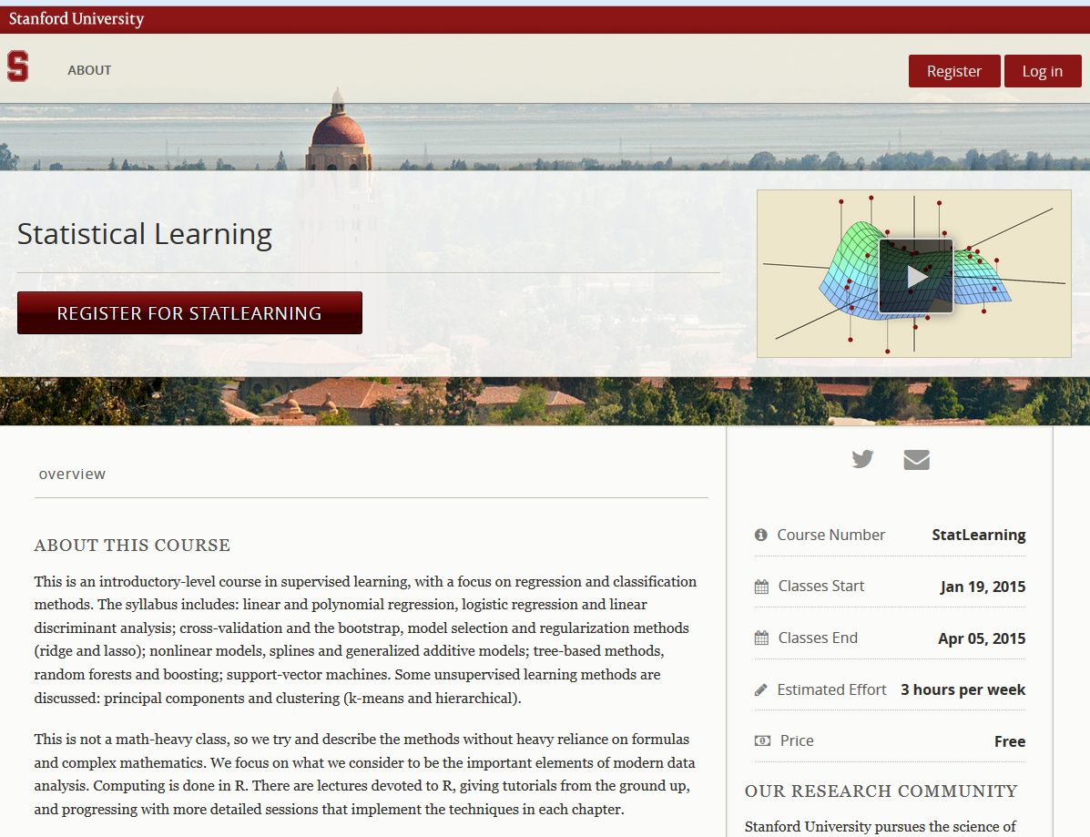
A few good MOOCs

Slide 10
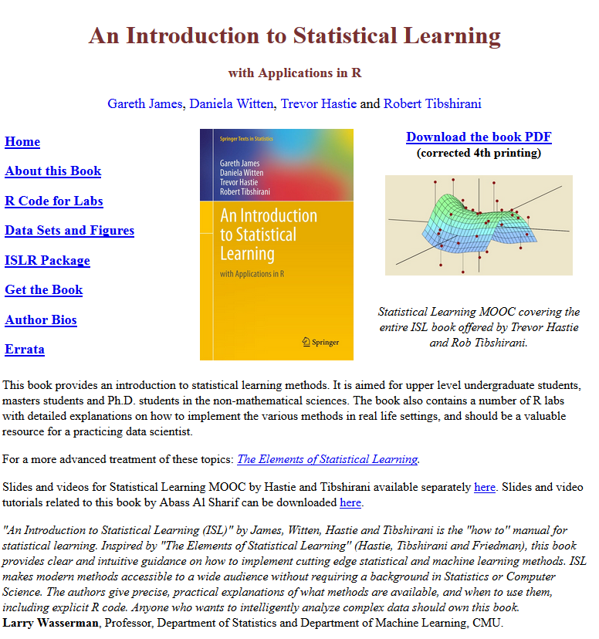
A few good (open, free) books

Slide 11
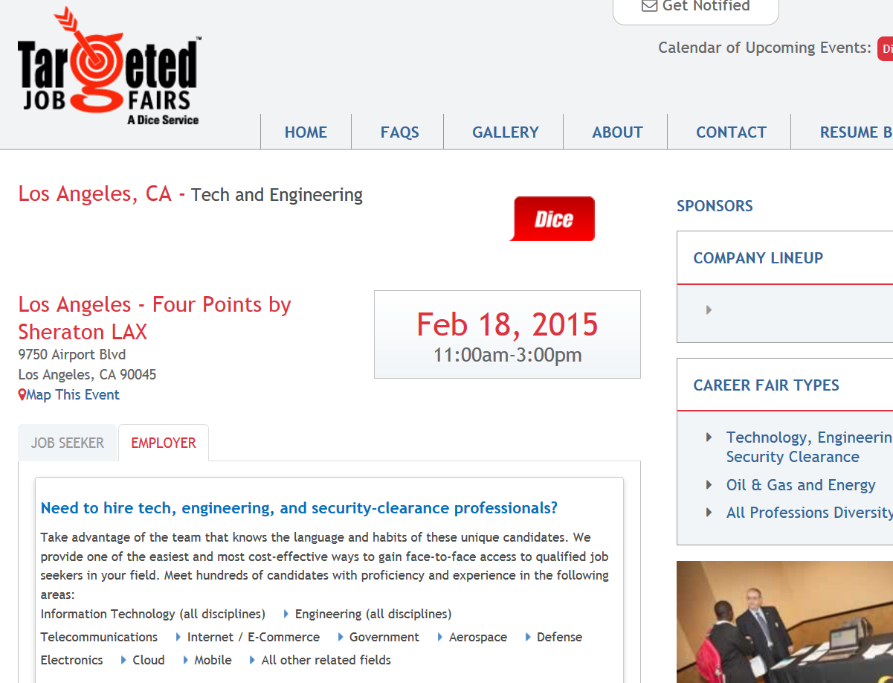
Highly granular “career/tech fairs”

Slide 12
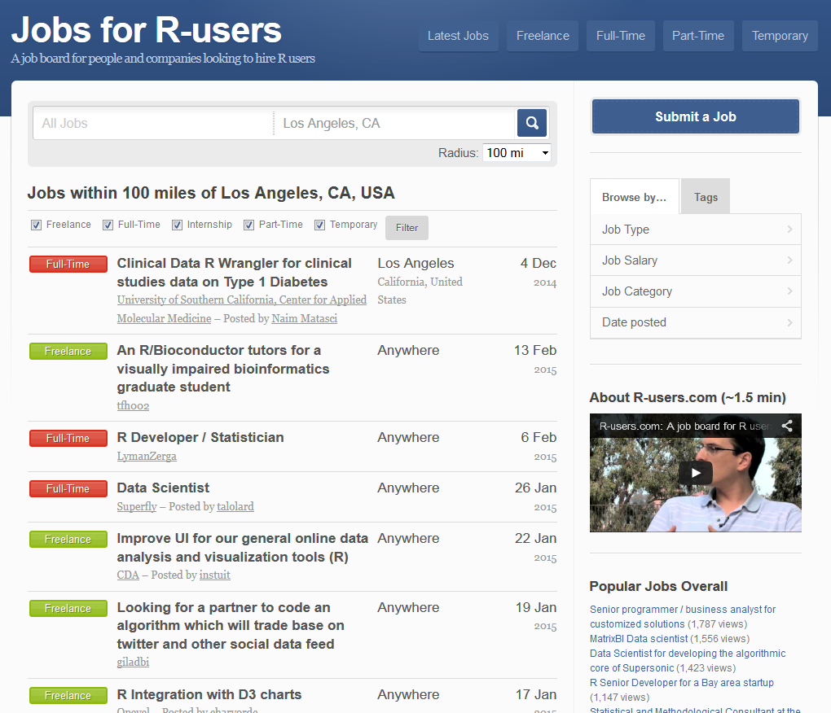
Specific “job postings/sites”

Slide 13
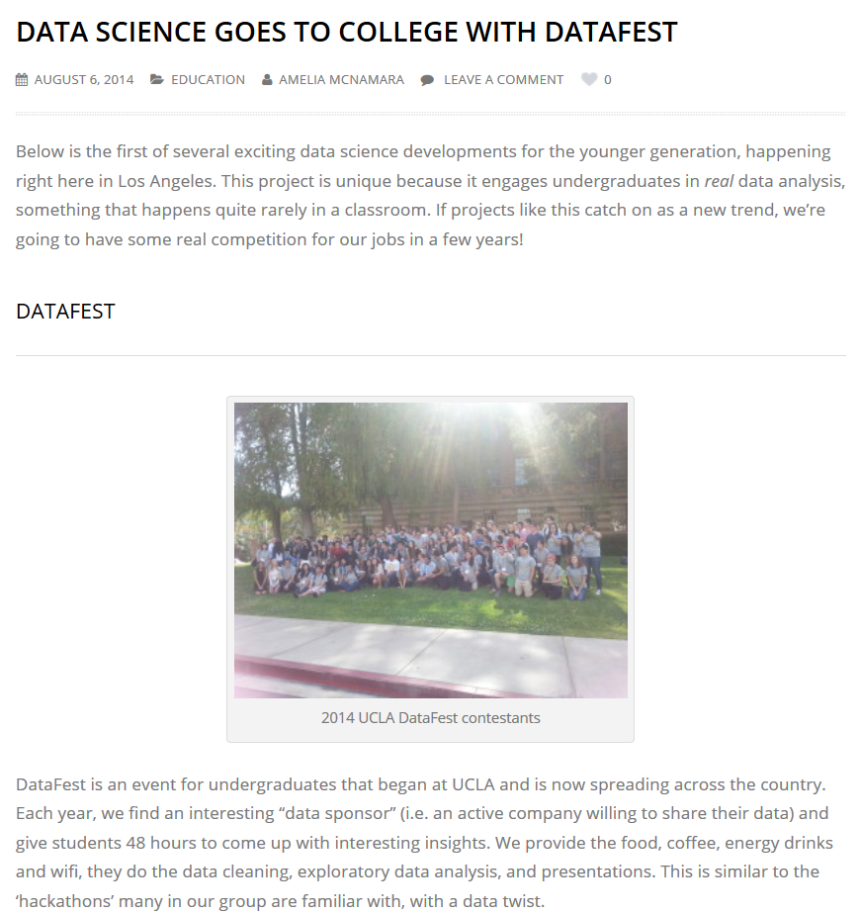

Slide 14
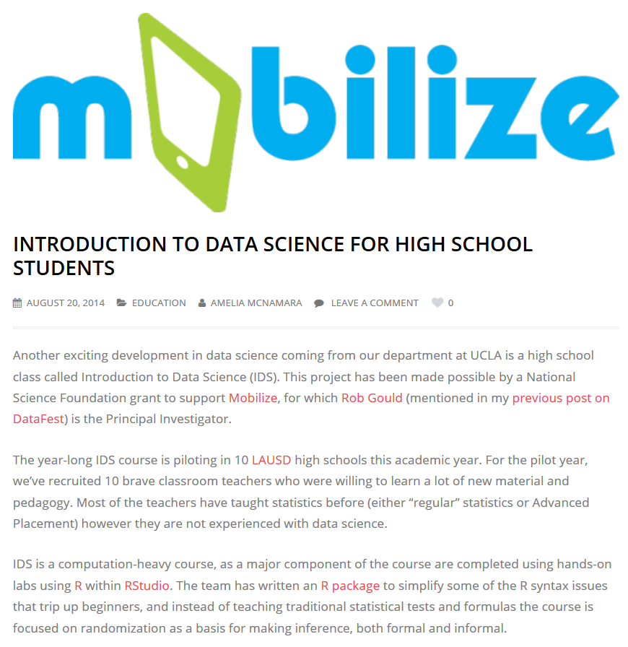
Should a semester of “data science” substitute for second-semester Algebra II in LAUSD?

Slide 15
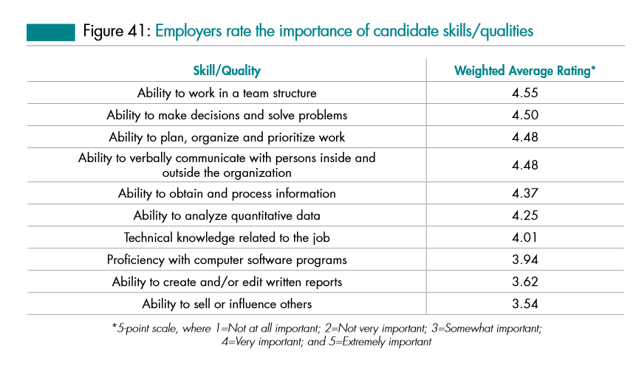
Relative importance of “data science” skills, knowledge, and abilities in general B.A./B.S.?
Source: Job Outlook 2014, National Association of College and Employers

Slide 16
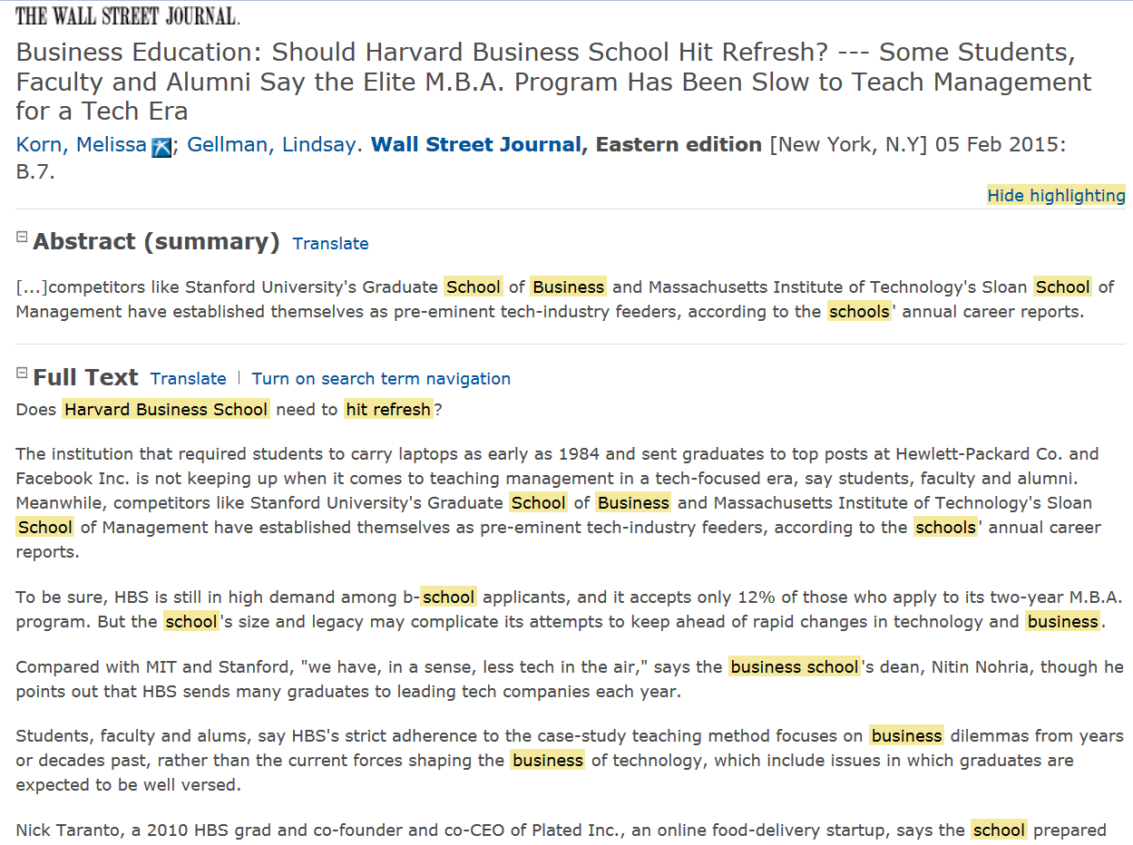

Slide 17
4-year Schools in this New “Service” Economy in CA?
USC, M.S. (part of the C.S. Dept.)
http://www.cs.usc.edu/academics/masters/msdata.htm
UCI Extension, certificate
http://unex.uci.edu/areas/it/data_science/
UC Berkeley, M.S. (online) (part of the School of Information)
http://datascience.berkeley.edu/
CSU Fullerton, certificate, online, accelerated
http://extension.fullerton.edu/professionaldevelopment/certificates/data-science
Near Fails:
UCOnline – Outside investors want the students, faculty, and curriculum, but not the bureaucracy.
CSUOnline – Severe misunderstanding of the market dynamics for this service catchment group.
Is CSU (mainstream) appropriate? Inter-disciplinary? Other approaches/ideas?

Slide 18
CCC’s in this New “Service” Economy?
15 CA Community Colleges will offer Bachelor’s Degrees beginning in 2017.
Airframe manufacturing technology, Antelope Valley College
Industrial automation, Bakersfield College
Emergency services and allied health systems, Crafton Hills College
Mortuary science, Cypress College
Equine industry, Feather River College
Dental hygiene, Foothill College and West Los Angeles College
Bio-manufacturing, Mira Costa College
Respiratory care, Modesto Junior College and Skyline College
Automotive technology, Rio Hondo College
Health information management, Mesa College
Occupational studies, Santa Ana College
Interaction design, Santa Monica College
Health information management, Shasta College

Slide 19
Candidate Explanations (1/4) (STEMish)
Mathematics
Abstract (“pure”) Reasoning, esp. w/ functions over Empirical (“applied”) Method esp. w/ algorithms
“Employers value concrete results with data; I need to know computer and data technologies.”
Statistics (stochastic inference)
Privilege specification (narrow, overfitted results) over generalization (broader theory development)
“If I have more data, then I believe that I will have proportionally more information.”
Engineering
Scale; Parallelism; “Utility Computing”
“My (often, very) small firm uses Amazon EC2, Google Compute Engine, and Microsoft Azure.”
Computer Science (machine learning)
Clustering, classification, dimension reduction, cross-validation, feature extraction, and convexity
“I need computationally-intensive and unsupervised (no response var.) approaches for big data”.

Slide 20
Candidate Explanations (2/4) (Sociological)
Psychology
Ego-centrism, absolutism, and perhaps, (philosophically) nihilism
“You don’t know me! Universities mostly just teach theories and I mostly just learn how to write papers.”
Sociology
Exponential Random Graph Models (agent- and ego-networks)
“I just need to immerse myself in the right industry, the right organization, and the right community eco-system.”
Cognitive Science
Exploratory, Dynamic Visualization is the new Descriptive Statistics
“Don’t use messy assumptions, hypotheses, models, inference, and diagnostics; just display high-dimensional graphs.”
Political Science
Rational Choice theory (perceived minimal efficacy in structural, government change); Elite theory
“If I don’t take this job, someone with an H1-B Visa might; besides an income, I gain power through my skills.”
Higher Education
Just-in-time training (short-term, practical) is different than just-in-case education (long-term, holistic).
“I want shallow, just-in-time theories for my practice (to answer the boss’ questions next week).”
K-12 Education
Auto-didactism, Self-directed learning
“Technology is ubiquitous; I can learn myself from Linux, Raspberry Pi, Apps, Arduino projects, and 3D printing.”

Slide 21
Candidate Explanations (3/4) (Economic/Business)
Neo-Classical Economics
Supply and Demand
“There is a shortage of individuals with “data scientist” skills; I can exploit that market disjunction.”
Empirical Finance
Loan-to-Value
“I might not achieve my potential, but at least I’m not in debt.”
Information Systems
Data management; Complex SQL Joins; rectangular transformations; unstructured text; file I/O
“The difficult data queries all come through me anyway; I’ll might as well do the analysis too.”
Management
Organizational Theory (matrix functions); Extreme Theory Y
“I don’t want to. work for the man; I really, truly have an entrepreneurial mindset in my soul.”

Slide 22
Candidate Explanations (4/4) (Other/Interdisciplinary)
Behavioral Economics
Extreme Discounting
“I am deliberately overweighting short-term preferences and underweighting long-term goals.”
History
Merchant-Craftsmen (some land) and Craft Guilds (no land) (apprentice → journeyman → master)
“Trades[men] and crafts[men] have always created local, supportive, and persistent communities.”

Slide 23
Open Questions
Is this observation an itinerant, ephemeral fad or a persistent structure?
Is this eco-system geographic-specific or due to its virtual nature, widespread?
Vis-à-vis other paid work, is this type of work off-shorable over time?
If this sector is indeed growing, is it still just a small part of the economy anyway?
Is this phenomenon (like some other aspects of IT) gender-skewed?
Does the evidence suggest privileging competencies over degrees?
Is my anecdotal experience with these “professionals”, ultimately, the triumph of practice over theory (as seen from the perspective of a prospective, potentially confused, soon-to-be-in-some-debt-from-a-student-loan CSU student)?

Slide 24
Open Questions
Without college degrees, how will these “data scientists” eventually lead/be ethical/well-rounded, etc. over a 40-year career arc?
What about Licensing? Certifications? CPE? “Badges”? Join professional (paid) associations?
How will they get promoted? Corollary: How, if ever, will their model building get more rigorous?
Can they can just enroll into holistic B.S./B.A. (pre-M.S./M.B.A.) programs later in life?
If applied math, computer science, statistics, and business are all individual degrees now, then how could we possibly make a single “data science” degree (all of them together) in the future?
What is the role of Ph.D.’s and academics (other than paid consulting)?
If we help (e.g., lectures, provide experts, networking, FOSS software, etc.), are we, in fact, inadvertently and unexpectedly, helping some young folks not go to College?
What do we tell our Deans and Provosts about our deep involvement with individuals who able-but-unwilling to (traditional, B.A./B.S.) college?
Isn’t this phenomenon, if evident, just a new version of (yet one more) vocation?
The CSU, as one component of the CA Master Plan, doesn’t “train” individuals (non-professionals) into vocations. We “educate” individuals for broader (professional and life) success.
Does any of this matter to our programs in either the short-run or long-run?
Your thoughts?

Slide 25
Further Reading (peer reviewed)
Baumer, B., Centinkaya-Rundel, M., Bray, A., Loi, L., and Horton, N. (2014) , “R Markdown: Integrating A Reproducible Analysis Tool into Introductory Statistics”, Technology Innovations in Statistics Education, 8(1) [ https://escholarship.org/uc/item/90b2f5xh ]
Brynjolffson, E., Hitt, L. M., and Kim H. H. (April, 2011), Strength in Numbers: How does data-driven decision-making affect firm performance? (working paper) [ http://ssrn.com/abstract=1819486 ]
Cetinkaya-Rundel, M., Diez, D., and Barr, C. (2013) , “OpenIntro Statistics: an Open-source Textbook”, Technology Innovations in Statistics Education, 7(3) [ https://escholarship.org/uc/item/6ms0x5nf ]
Finzer, W. (2013) , “The Data Science Dilemma”, Technology Innovations in Statistics Education, 7(2) [ https://escholarship.org/uc/item/7gv0q9dc ]
Friedman, J. (2001) , “The Role of Statistics in the Data Revolution”, International Statistical Review, 49(1) p. 5-10

Slide 26
Further Reading (peer reviewed)
Garfield, J., and Ben-Zvi, D. (2007) , “How Students Learn Statistics Revisited: A Current Review of Research on Teaching and Learning Statistics”, International Statistical Review, 75(3) p. 372-396
Gould, R. (2010) , “Statistics and the Modern Student”, International Statistical Review, 78(2) p. 297-315
Hardin, J., Hoerl, R., Horton, N., and Nolan, D. (Oct. 12, 2014), Data Science in the Statistics Curricula : Preparing Students to “Think with Data” [ http://arxiv.org/ftp/arxiv/papers/1410/1410.3127.pdf ]
Horton, N., Baumer, B., and Wickham, H. (Feb. 1, 2015) , “Setting the stage for data science: integration of data management skills in introductory and second courses in statistics” [ http://arxiv.org/pdf/1502.00318.pdf ]
Kaplan, D. (2007) , “Computing and Introductory Statistics”, Technology Innovations in Statistics Education, 1(1) [https://escholarship.org/uc/item/3088k195 ]

Slide 27
Further Reading (peer reviewed)
Koenker, R., and Mizera, I. (2014), “Tidy Data”, Journal of Statistical Software, 60(5) Sep. [ http://www.jstatsoft.org/v60/i05/paper]
Nolan, D., and Lang, D. T. (2010), “Computing in the Statistics Curricula”, American Statistician, 64(10) p. 97-107 [ http://www.stat.berkeley.edu/~statcur/Preprints/ComputingCurric3.pdf ]
Tambe, P. (April, 2011), “Big Data Investment, Skills, and Firm Value”, Management Science (pre-print) [ http://papers.ssrn.com/sol3/papers.cfm?abstract_id=2294077 ]
Wickham, H. (2014), “Tidy Data”, Journal of Statistical Software, 59(10) Aug. [ http://www.jstatsoft.org/v59/i10/paper ]

Slide 28
Further Reading (non peer-reviewed)
Davenport, T., and Patil, D. J. (2012), “Data Scientist: The Sexiest Job of the 21st Century”, Harvard Business Review, October.
History of the Organization of Work
http://www.britannica.com/print/topic/648000
Los Angeles Economic Development Corporation
High Tech in LA (October, 2014)
http://laedc.org/wp-content/uploads/2014/10/High-Tech-in-LA_20141006_FF.pdf
McAfee, A., and Brynjolfsson, E. (2012), “Big Data: The Management Revolution”, Harvard Business Review, October.
McKinsey Global Institute Report (Manyika, J. et al.)
Big data: The next frontier for innovation, competition, and productivity (May, 2011)
http://www.mckinsey.com/insights/business_technology/big_data_the_next_frontier_for_innovation

Slide 29
Further Reading (additional references)
Journals:
J. of Data Science; Big Data; Machine Learning; Data Mining and Data Discovery; J. of Statistical Science; Technology Innovations in Statistical Education; International Statistical Review; J. of Statistics Education; Intl. J. of Math. Ed. In Science and Tech.
Periodicals
Analytics Magazine (http://www.analytics-magazine.org/)
“Academic” Conferences
INFORMS Big Data conference (April, 2015) (Huntington Beach, CA)
http://meetings2.informs.org/wordpress/analytics2015/
ACM SIGMOD “Management of Data” conf. (May/June, 2015) (Melborne, VIC, AU)
http://www.sigmod2015.org/
ACM KDD “Knowledge Discovery and Data Mining” conf. (Aug, 2015) (Sydney, AU)
http://www.kdd.org/kdd2015/
“Practice” Conferences
R Users Conference (June/July, 2015) (Denmark) (2014 was held at UCLA)
R in Finance 2015; PythonQuants Conference 2014; SciPy 2015; JuliaCon 2015
Organizations
AMERICAN INSTITUTE OF BIG DATA PROFESSIONALS (http://aibdp.org/)

